Slide 1
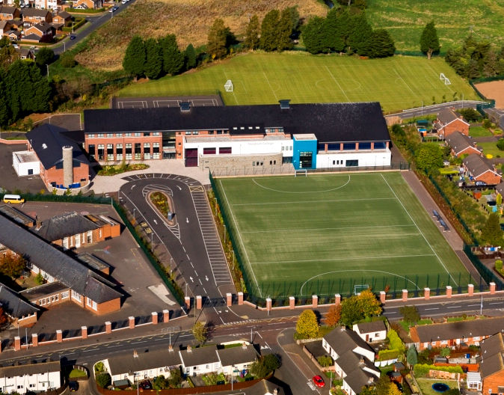
Semper Sersum
Nendrum College
House System
A sense of belonging

Slide 2
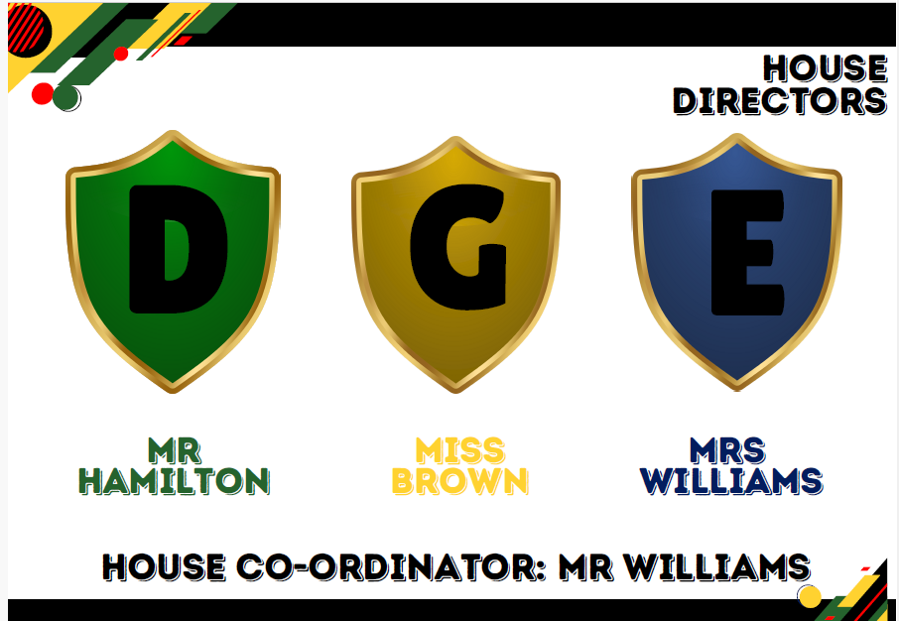
HOUSE DIRECTORS

Slide 3
The Role of our House Captains:
Leadership: House Captains lead their house in various activities, setting a positive example for other students.
Organisation: They help organise house events, such as sports competitions, cultural activities, and charity drives.
Representation: House captains represent their house in school meetings and events, voicing the opinions and concerns of their house members.
Motivation: They encourage and motivate students to participate in house activities and strive for excellence.
Teamwork: House captains work closely with other house leaders and school staff to ensure smooth execution of events and activities.

Slide 4
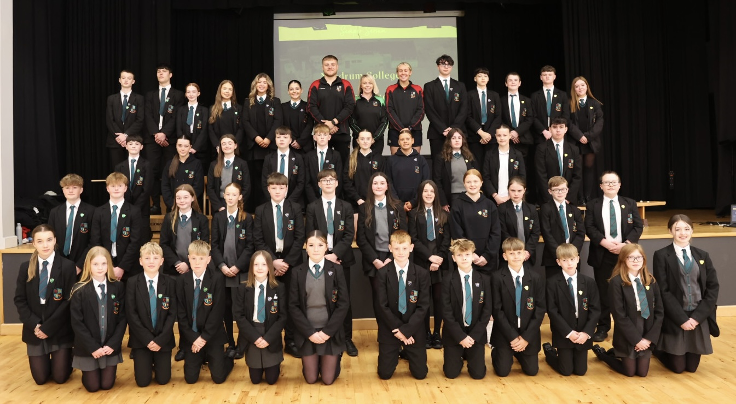

Slide 5
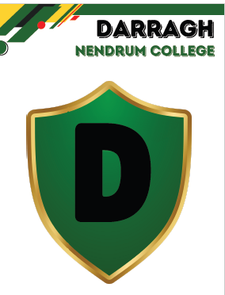

Slide 6
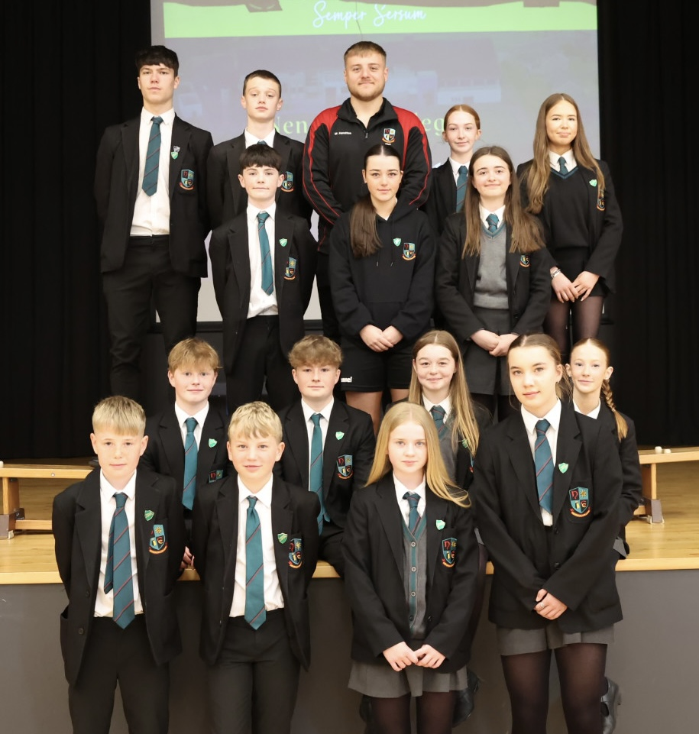
Darragh House Captains:

Slide 7
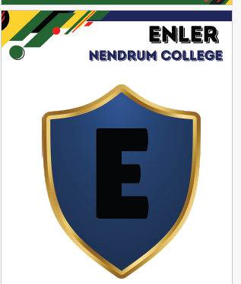

Slide 8
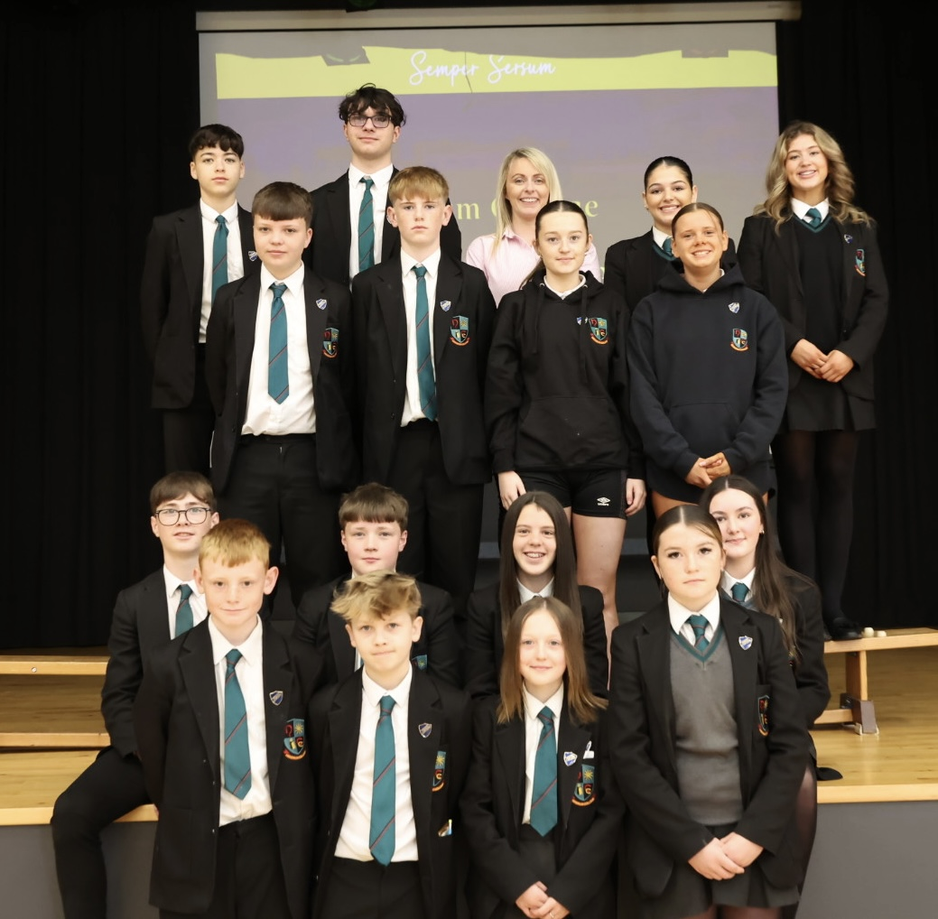
Enler House Captains:

Slide 9
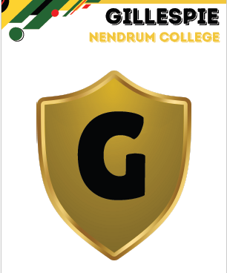

Slide 10
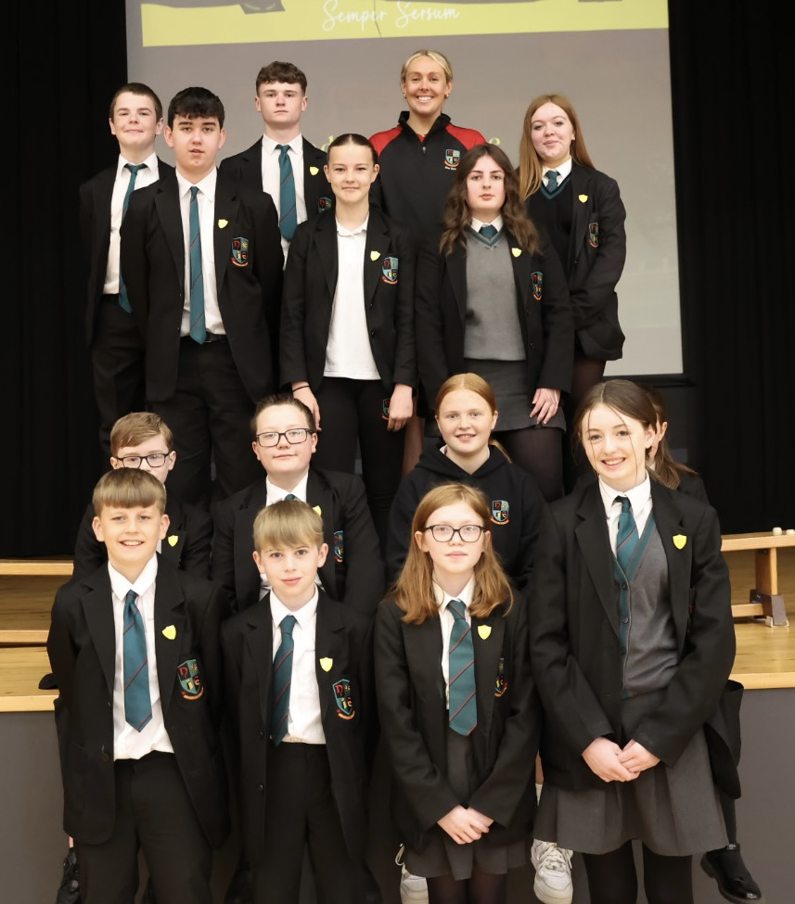
Gillespie House Captains:

Slide 11
Our School Matters
DARRAGH ENLER GILLESPIE

